Slide 1
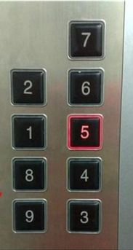
Fundamentals of Interaction Design
CSCI 5839 Fall 2021

Slide 2
This week
Principles of usability
How should we think about usability problems and why they happen?
What are the known best practices for user interfaces in general?
How do we use known best practices to systematically test our interfaces?

Slide 3
Today
Norman’s model of cognition and interaction
Features of Norman’s model

Slide 4
Norman’s model of interaction

Slide 5
Who is Don Norman?
Early user researcher at Apple, cofounder of Nielsen Norman Group, most recently at UCSD
Trained as a psychologist, turned focus to engineering in the 1980s
Provides usability guidelines, but more importantly offers a framework for explaining usability problems
Notes:
Norman is 85 in 2021 – and still working
Don Norman image via Wikimedia: https://en.wikipedia.org/wiki/File:Donald_Norman_at_AWF05.jpg

Slide 6
Design of Everyday Things
Best known book on user interfaces
Largely known for introducing idea of affordances
But more importantly imo is the model of cognition
Notes:
AKA Psychology of Everyday Things

Slide 7
tl;dr on Norman
Humans do a lot of (mostly unconscious) cognitive work to understand the systems they interact with
This involves both perceiving and interacting with the system
User interfaces communicate the “rules” of interaction (intentionally and not)
Usability problems occur when there are mismatches between user’s understanding and the system
Notes:
Note the title: Used to be POET, now DOET

Slide 8
Door handles and teapots
Getting this work right is not about memorizing specific usability problems
It’s actually about predicting successful and unsuccessful interactions, often in unfamiliar settings
Thus, we can find examples of these phenomena everywhere around us
Notes:
It may be helpful to practice these skills in contexts that are different than what we’re used to – like low tech interactions.
Image: https://michaellutjen.com/blog/norman-doors-centered-design/

Slide 9
Norman: key ideas
Action cycle
Gulfs of execution and evaluation
Conceptual models
Affordances
Mapping
Constraints
Feedback
Notes:
tons of wisdom in this one chapter!

Slide 10
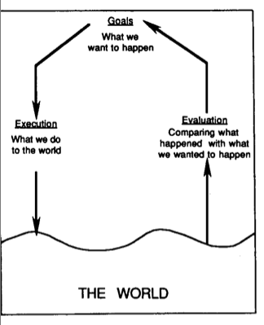
The Action Cycle Gulfs of Execution and Evaluation
Imagine you are a UI designer for an ATM manufacturer
Your UX engineer comes to you with the feedback: “our test participants couldn’t figure out how to withdraw cash”
… now what??
Notes:
Not in our reading but worth understanding

Slide 11
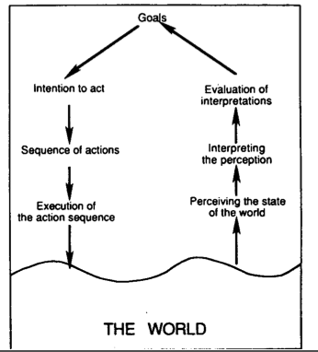
Norman’s 7-stage model Gulfs of Execution and Evaluation
Norman’s 7-stage model gives us language to talk about when “users couldn’t figure it out,” act on it!
Gulf of execution: —can’t find it, can’t figure out how to go to the next step
Gulf of evaluation: — don’t know whether it worked, don’t know when to go to the next step
Notes:
Not in our reading but worth understanding

Slide 12
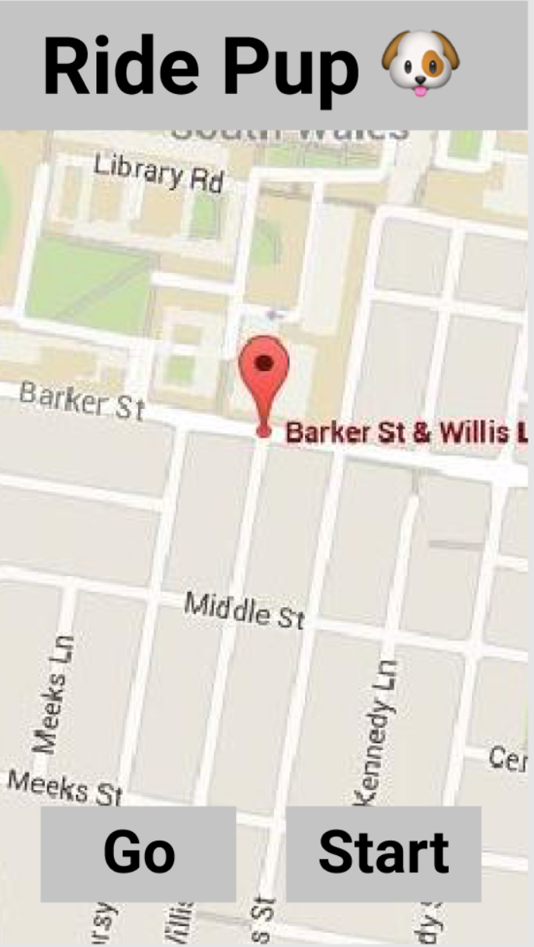
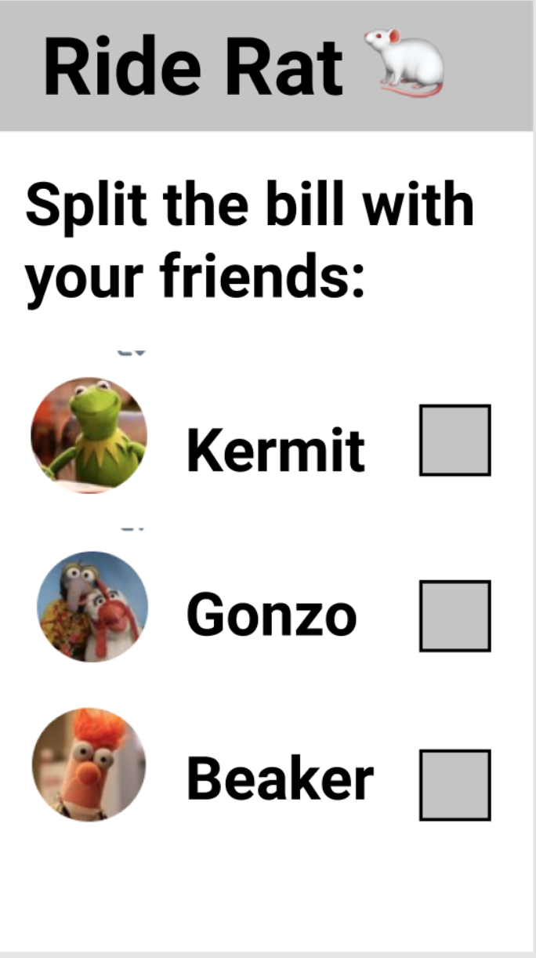
Execution and evaluation fails

Slide 13
Conceptual models
What does the user think is happening?
Human beings try to predict – what will happen if I do X?
We are “naïve scientists”
Designers can influence the formation of the user’s conceptual model

Slide 14
How models help
The designer can present a simplified model (if it matches user behavior)
Notes:
What’s actually happening here? Lots of complex modeling going on here, but it translates to “turn CW/CCW for more/less heat”

Slide 15
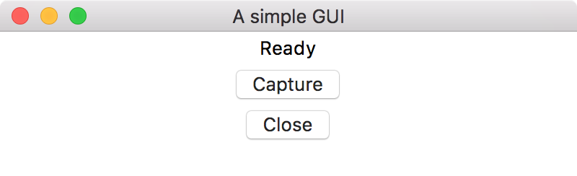
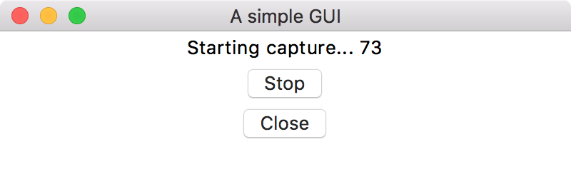
How models can hurt
If user’s conceptual model disagrees with how the system actually works, unexpected problems can occur
The actual code:
capture.onPress() {
while (1) {
// capture image in memory
images.append(capture)
print(“Starting capture…” + i);
}
}
stop.onPress() {
foreach(img in images) {
img.save() // save to disk
}
}
Notes:
If you take the time to understand Norman’s example, it’s a good example
But here is another – a screen capture program. It’s not actually saving until the end.

Slide 16
How models can hurt
If user’s conceptual model disagrees with how the system actually works, unexpected problems can occur
Expectation: when I press capture, it saves images until I close the program
capture.onPress() {
while (1) {
// capture image in memory
images.append(capture)
print(“Starting capture…“ + i);
}
}
stop.onPress() {
foreach(img in images) {
img.save() // save to disk
}
}
Reality: when I press capture, it saves images to a buffer. When I press stop, it saves them to disk
Notes:
And yes, this is fixable with an easy fix (disable the close button; automatically save before quitting)

Slide 17
More on conceptual models
We unconsciously build a mental simulation of the technology we interact with
Implementation is often complicated and ugly
Designers have the opportunity to present a simplified model to the user
But problems can appear when
Users misunderstand the model
Simplified model has a mismatch with actual system

Slide 18
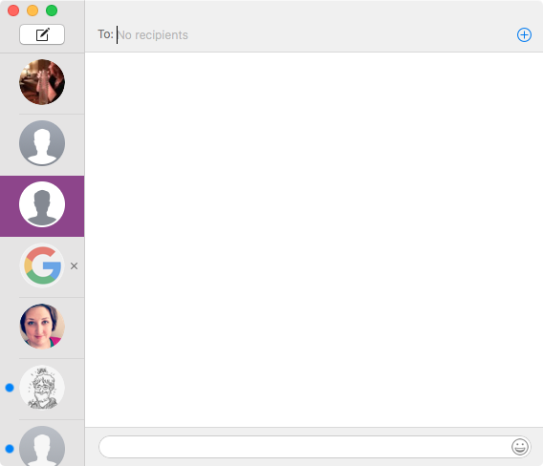
Addresses in iMessage
Actual implementation is complicated: how messages are sent depends on sender’s device, recipient’s device, whether sending to a phone number or Apple ID, whether sender is blocked, whether it’s a group chat, etc.
User model is “just type recipients into the box and iMessage figures it out”
We could imagine worse versions of this: e.g. different tabs to send an SMS or an iMessage

Slide 19
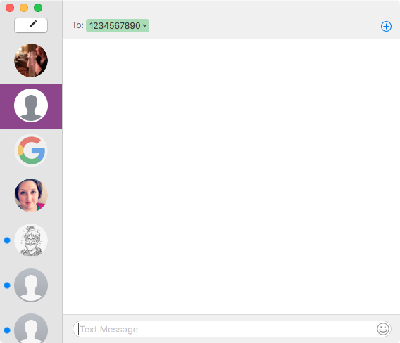
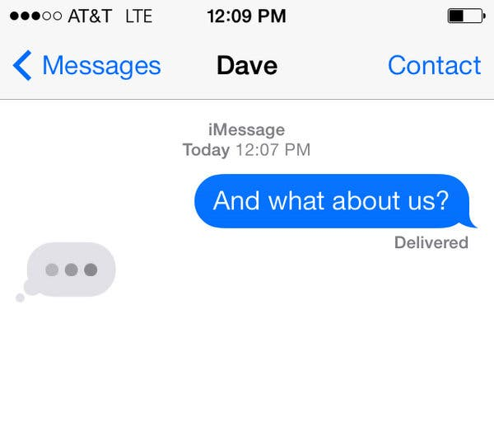
Sending messages
What happens when I type?
When does the recipient know that I’m typing?
One conceptual model: text stays in the text box until I click send
Confusion if this is incorrect

Slide 20
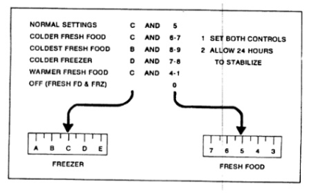
Norman’s refrigerator

Slide 21
Affordances, feedback, constraints, mapping
Our tools to solve usability problems!
Worth understanding their nuances —these terms have very specific definitions —important to be able to distinguish these

Slide 22
Beginner’s mind
Practice looking at things without our preconceptions
It’s difficult for us to know why we know something
And thus whether our typical user would know it, how they would learn it
We need to think very consciously about things that are processed unconsciously
Notes:
Concept from Zen Buddhism

Slide 23
How we mess this up
Dismiss something as “obvious”
Not notice details
A real danger here is that we notice things that are bad but not things that are good

Slide 24
Demonstration
What is communicated by this object?
Ignoring what we know about it, its similarity to other things we know

Slide 25
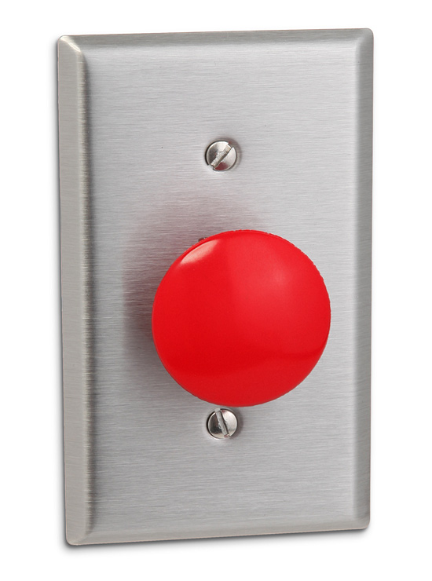
Affordances
Structure action without instruction

Slide 26
History of affordances
JJ Gibson, ants walking on a path
What looks like very complex behavior is guided by the layout of the environment
Notes:
Ants: https://sixlegsphoto.files.wordpress.com/2013/02/pachycondyla_raid.jpg

Slide 27

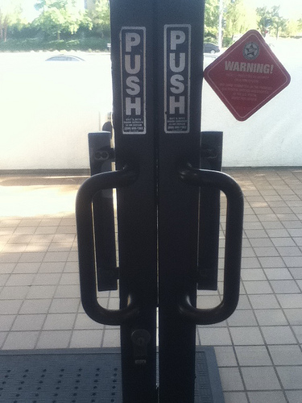
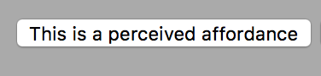
These are NOT affordances
No! ---->

Slide 28
Using affordances
Communicate where to look, where to interact
Can indicate constraints
They usually involve nonverbal communication

Slide 29
Real vs. perceived affordances
How new users understand what to do: Four principles for screen interfaces
1. Follow conventional usage, both in the choice of images and the allowable interactions.
2. Use words to describe the desired action (e.g., "click here" or use labels in front of perceived objects).
3. Use metaphor
4. Follow a coherent conceptual model so that once part of the interface is learned, the same principles apply to other parts
Notes:
https://jnd.org/affordances_and_design/

Slide 30
System status and feedback
What just happened?
What is the system doing?
Is it accepting input?
What can I do from here?
Notes:
Feedback has a specific definition here

Slide 31
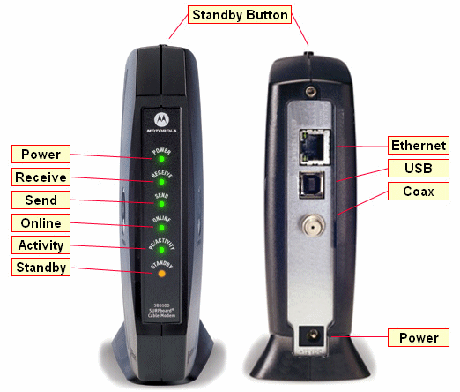
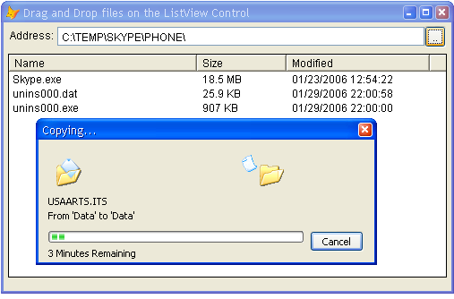
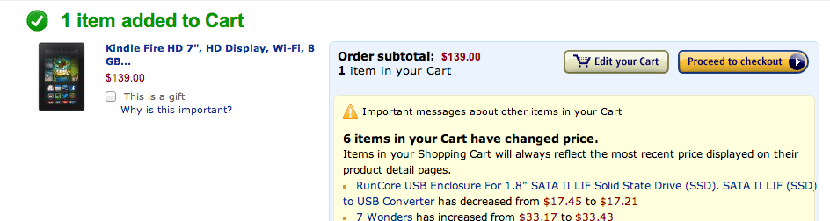
System status and feedback
Notes:
Modem can be useful, but only for experts
The others are good in that they show what’s happening, progress

Slide 32
What is feedback?
Any part of our designed interaction can be feedback
Not just for “output areas”
May be complex (CPU lights) or subtle (click of a door lock)

Slide 33
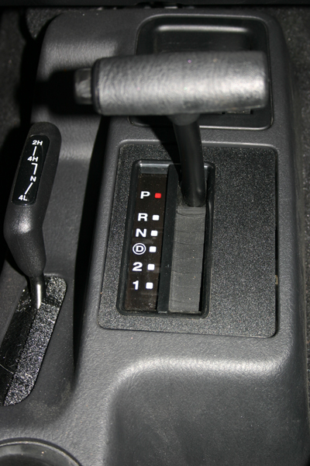
Constraints
We might frst think they’re bad, but they’re actually good
Guide behavior and limit undesired actions
Notes:
What is the constraint here?
It’s not the linear movement, it’s the fact that you can’t go between reverse and drive without going through neutral

Slide 34
Constraints
Constraints limit user actions
Can’t move between R and D without going through neutral
Notes:
What is the constraint here?
It’s not the linear movement, it’s the fact that you can’t go between reverse and drive without going through neutral

Slide 35
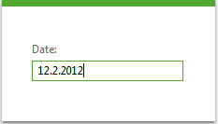
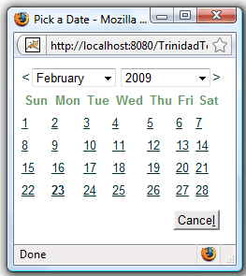
Constraints for date pickers
What problems might occur with #1 but not #2?
Can add error checking to #1 but then:
Date handling logic becomes much more complicated
Users can encounter frustrating errors
User knows they might make an error
Notes:
Incorrectly formatted date, European style date, not a real date (January 39th), date is in the future or past, user just doesn’t know what the date is

Slide 36
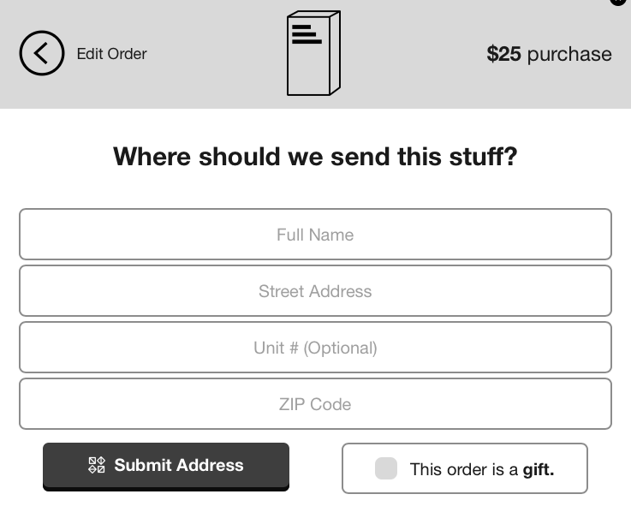
Using constraints wisely
Doing more work so our users can do less
Apply understanding of the domain
Prevent problematic input (when you can) by making appropriate assumptions
Control order of operations, input types (e.g. request address before shipping options)

Slide 37
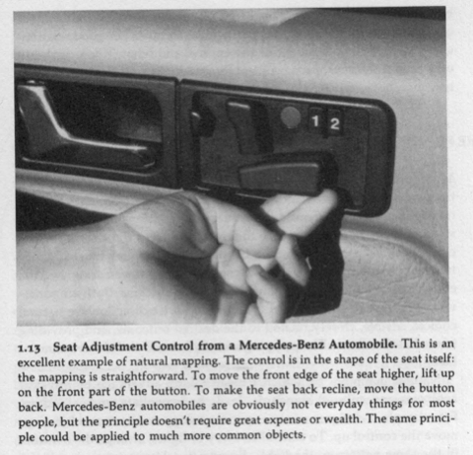
Mapping
Relation between controls and the things that they control
Good mappings logically map the input to the possible effects in a way that is logical
Bad mappings are arbitrary or require instruction
Users sometimes tacitly know mappings without realizing it!
Notes:
avoiding use of intuitive here – often it’s not really intuitive
+ saying intuitive masks what’s going on

Slide 38
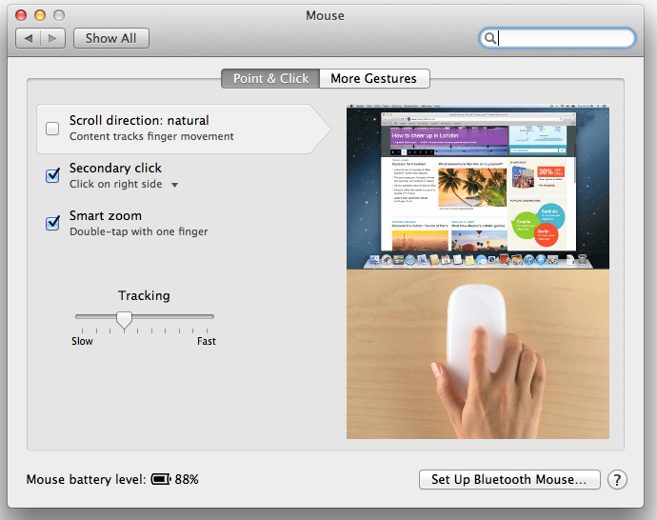

Mapping for gestures
What happens when I gesture in this direction?
Natural mapping
Notes:
Can be especially important for gestures
For the book? Which direction?

Slide 39

Mapping for gestures
What happens when I gesture in this direction?
Notes:
Can be especially important for gestures
For the book? Which direction?

Slide 40
Activity for today
Pair up with 1 or 2 people
Find examples of the following in the building: Affordances, signifiers, system status/feedback, constraints, mapping
Make a list of the item and an explanation of why it is that item

Slide 41
Usability, continued

Slide 42
Other perspectives on usability
Interaction as grammar
Tools that are ready-to-hand
Emotion in design
Usability heuristics

Slide 43
Interaction as grammar
Often in GUIs we have to both choose an object and an action to perform
Which should come first? Why?
What does Norman tell us about this?

Slide 44
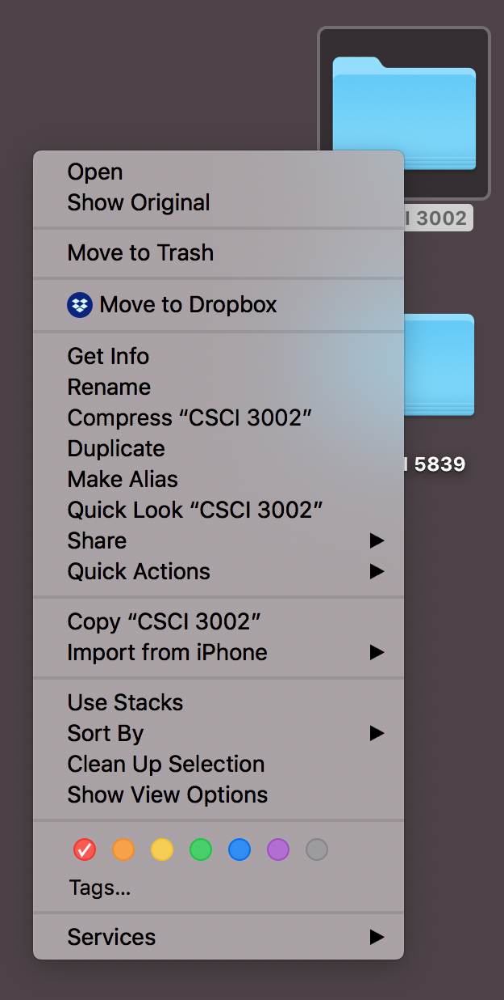
Benefits of Noun-Verb
For most operations, we know what we want to act on first
Don’t know available operations or their names (gulf of execution)
Can only show valid actions (constraint)
Can provide hints about the effects of those actions (feedforward)

Slide 45
Examples of verb-noun interaction
Examples?
Some examples
Voice interfaces
Drawing apps (sort of)

Slide 46
Usability as invisibility
Philosopher Martin Heidegger in Being and Time (1927):
“The peculiarity of what is proximally [present] to hand is that, in its readiness-to-hand, it must, as it were, withdraw … that with which we concern ourselves primarily is the work …”
Ready-to-hand – expert use, focus on the task and don’t even think about the tool
Present-at-hand – unskilled use, thinking directly about manipulating the tool
Notes:
Heidegger portrait: https://en.wikipedia.org/wiki/Martin_Heidegger
Hammer image from http://alandix.com/blog/2010/08/12/struggling-with-heidegger/

Slide 47
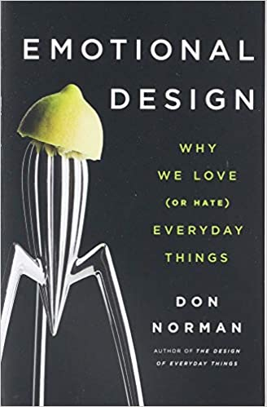
Emotional Design (Norman, 2004)
Notes:
http://libraries.colorado.edu/record=b9765157~S3
A nice complement to Design of Everyday Things

Slide 48
Emotional Design (Norman, 2004)
Three levels of design
Visceral – raw emotional/physical experience
Behavioral – does it work the way I expect?
Reflective – how does using this affect my perception of myself, life, the universe, everything?

Slide 49
Emotional Design (Norman, 2004)
Three levels of design
Visceral – raw emotional/physical experience
Behavioral – does it work the way I expect?
Reflective – how does using this affect my perception of myself, life, the universe, everything?

Slide 50
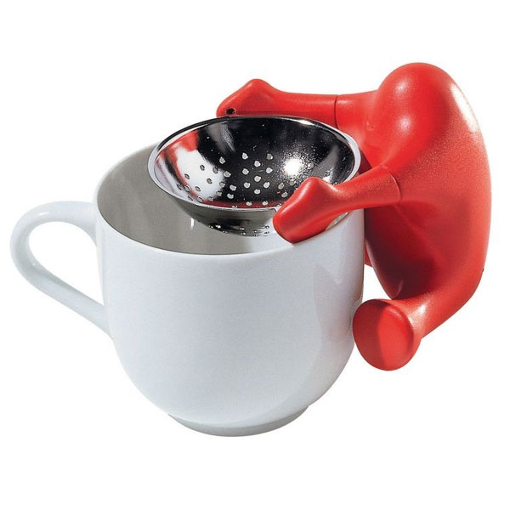
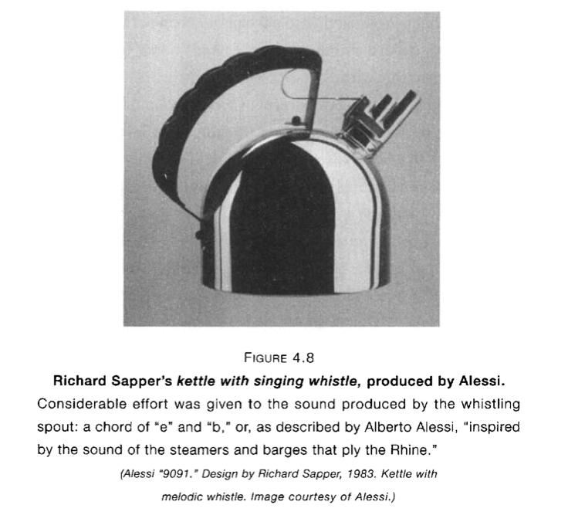
Playfulness and fun
Alessi tea strainer

Slide 51
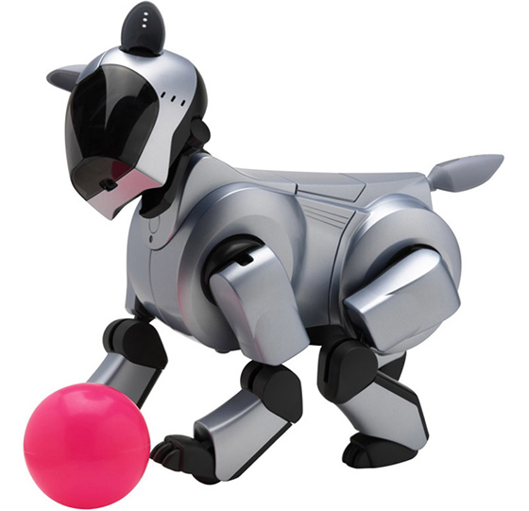
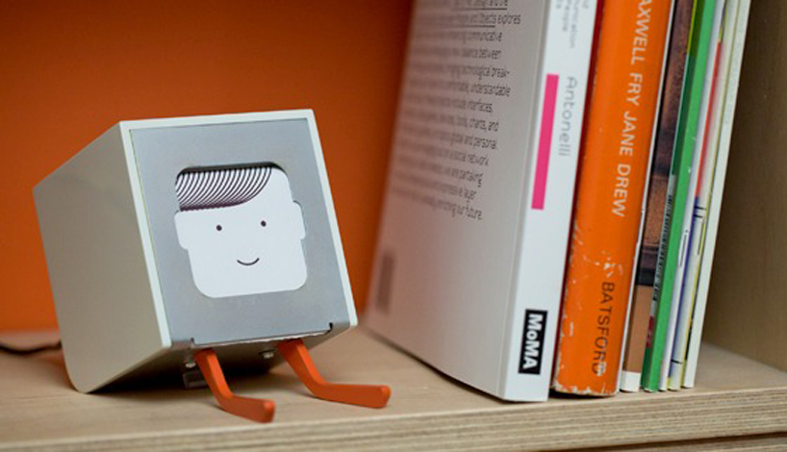
Technology with personality
BJ Fogg, “computers as social actors”
Physical: Face, eyes, body, movement
Psychological: Preferences, humor, personality, feelings, empathy, "I'm sorry"
Language: Interactive language use, spoken language, language recognition
Social Dynamics: Turn taking, cooperation, praise for good work, answering questions, reciprocity
Social Roles: Doctor, teammate, opponent, teacher, pet, guide

Slide 52
Other aspects of design
Ergonomics / human factors
Accessibility / universal design

Slide 53
Heuristic Evaluation

Slide 54
Heuristic evaluation
Useful when you already know what the usability problems are
Catch obvious bugs (so test participants can help with the more important issues)
Systematic method that can help document *all* the usability bugs
Encourages thinking through the underlying problem, then considering possible solutions
Notes:
Worst thing to do is spend time/money on a user test and realize you left out a button, misspelled something, etc

Slide 55
How to conduct a heuristic evaluation
Choose your heuristics (including custom heuristics)
Systematically analyze each component of the interface (e.g. screens) using your heuristics —screen by screen, heuristic by heuristic, task by task
Log each problem (can leave details for later)
Complete documentation for each problem —detailed description, screen shot, which heuristic is being violated?, severity (high, medium, low), suggested solution (maybe)
Prioritize issues and fix them (or pass them on to someone who will)
Notes:
I prefer to test one heuristic at a time – I have found that it works better
Important to test in context. If you just look at a screen, might not
Solution – don’t get distracted by this

Slide 56
Nielsen’s 10 heuristics
Set of good practice heuristics that apply to many types of interactive systems
But custom heuristics may work better for your design project

Slide 57
Visibility of system status
The system should always keep users informed about what is going on, through appropriate feedback within reasonable time.
Match between system and the real world
The system should speak the users' language, with words, phrases and concepts familiar to the user, rather than system-oriented terms. Follow real-world conventions, making information appear in a natural and logical order.
User control and freedom
Users often choose system functions by mistake and will need a clearly marked "emergency exit" to leave the unwanted state without having to go through an extended dialogue. Support undo and redo.
Consistency and standards
Users should not have to wonder whether different words, situations, or actions mean the same thing. Follow platform conventions.
Error prevention
Even better than good error messages is a careful design which prevents a problem from occurring in the first place. Either eliminate error-prone conditions or check for them and present users with a confirmation option before they commit to the action.
Recognition rather than recall
Minimize the user's memory load by making objects, actions, and options visible. The user should not have to remember information from one part of the dialogue to another. Instructions for use of the system should be visible or easily retrievable whenever appropriate.
Flexibility and efficiency of use
Accelerators -- unseen by the novice user -- may often speed up the interaction for the expert user such that the system can cater to both inexperienced and experienced users. Allow users to tailor frequent actions.
Aesthetic and minimalist design
Dialogues should not contain information which is irrelevant or rarely needed. Every extra unit of information in a dialogue competes with the relevant units of information and diminishes their relative visibility.
Help users recognize, diagnose, and recover from errors
Error messages should be expressed in plain language (no codes), precisely indicate the problem, and constructively suggest a solution.
Help and documentation
Even though it is better if the system can be used without documentation, it may be necessary to provide help and documentation. Any such information should be easy to search, focused on the user's task, list concrete steps to be carried out, and not be too large.
Notes:
https://www.nngroup.com/articles/ten-usability-heuristics/

Slide 58
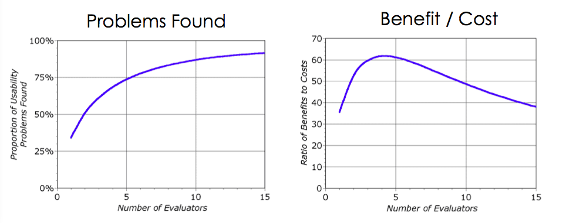
How many evaluators?
Nielsen recommends at least 3; 5 even better
Notes:
http://www.nngroup.com/articles/how-to-conduct-a-heuristic-evaluation/

Slide 59
Worksheet
Some people use worksheets to document heuristic evaluations (sometimes called Usability Aspect Report)
Not necessary, but can help keep you on task
See example on Moodle
What’s most important to track? —detailed description / reproduction steps, why it’s a problem (what heuristic)

Slide 60
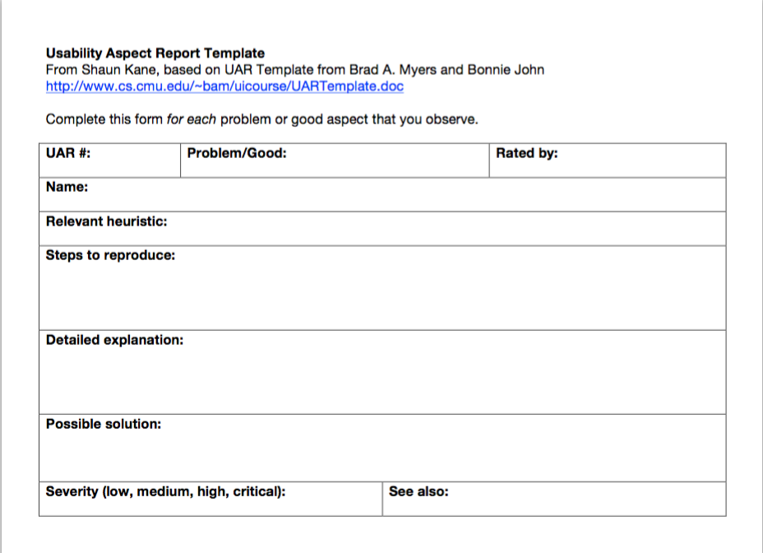

Slide 61
What makes a good X?
To get the most of this method, we may want to consider our own heuristics
Can be based on study observations, end user comments, prior studies
Notes:
shopping site?

Slide 62
Brainstorming heuristics
Let’s spend a few minutes brainstorming on usability heuristics for email inboxes
How might we rate whether an email inbox is well designed?
Notes:
Screenshots
Gmail: https://media.gcflearnfree.org/content/55e073847dd48174331f5193_01_17_2014/intro_labeled_graphic.jpg
Google inbox: http://ericgreer.info/assets/images/googleinboxweb.png
Apple Mail: https://support.apple.com/library/content/dam/edam/applecare/images/en_US/osx/yos_mail_conversations.png

Slide 63
Our email inbox heuristics

Slide 64
Our email inbox heuristics
Looks great
Customized
Sort and filter
Overview
Having folders
Determining priority of messages
Feedback
Supporting multiple identities
Easy access to features
Quick actions
Fewer clicks
Skimmable (reading pane)
Important things should be easy to find (“common tasks should be easy; rare tasks should be possible”)

Slide 65
Heuristics for your heuristics
(Separate out features)
Plan to have other people use them
Focus on the task
Think about radical new designs

Slide 66
Practicing heuristic evaluation
Pair up with 1-2 people
Choose some app or device
Pick a task
Go through the task and evaluate using Nielsen’s 10 heuristics
(aim for at least 5 issues)

Slide 67
Activity 2
Pair up with 1-2 partners
Goal: we are designing a set of gesture-controlled wireless headphones
What functions should it support? (try to come up with some interesting ones)
Design a set of interactions for controlling them – you can add gestures, add buttons, etc.
How can mappings, affordances and constraints help?
How can you give feedback?
You’ll act out a scenario where the user interacts with the device (and describe it, or sketch)

Slide 68
Activity 3
Pair up with 1-2 people
Consider Alexa
Evaluate with respect to:
Affordances
Constraints
Feedback
Mapping
Gulf of execution
Gulf of evaluation

Slide 69
Why DOET is important
Describes interaction as a cognitive process with multiple steps (action cycle)
Elements of user interfaces that interact with design cycle (affordances, etc.)
But you don’t have to take my word for it. It’s free online @ CU libraries
🌈

Slide 70
This week
Norman’s model: provides useful why explanations for usability challenges
Heuristic evaluation: method for systematically identifying and documenting usability problems
Notes:
We’ll cover these quickly this week – but they will return
These are different tools. Not directly related.

Slide 71
Avoiding design pessimism
Part of our goal at this stage is to find problems and to consider multiple solutions
Having just one solution will perpetuate the same problems we’ve already seen
We may be motivated to exclude possible solutions, and come up with reasons for doing so
Example: “We could add sound previews to the alarm, but that isn’t accessible to deaf people (so we shouldn’t do it).”
Be prepared to try multiple solutions and to handle trade-offs, rather than avoiding them

Slide 72
Monitoring our own laziness
As humans, we’re motivated to avoid unnecessary work
Especially around trying out different options, redoing or iterating on work
Make sure to understand when this line of thinking is motivating your decisions (and deal with it consciously)
Be thoughtful about where to put your energy
“I understand there’s a guy inside me who wants to lay in bed, smoke weed all day, and watch cartoons and old movies. My whole life is a series of strategems to avoid and outwit that guy.” –Anthony Bourdain

Slide 73
Two levels of thinking
System 1: fast, instinctive, emotional
Driven by prior experience, heuristics, sterotypes
System 2: slow, deliberative, logical
Our brain switches between thes modes; optimized for saving energy and using S1 when possible
Which do we want to bring to our creative work?
from Daniel Kahneman, Thinking Fast and Slow
Notes:
This model of thinking is very well established. It’s even possible to get people to switch between modes.
This is a lot of different ways to say “don’t half ass this”. But it’s an important point!

Slide 74
Outwitting our inner lazy self
Recognizing when we are drawn into taking shortcuts
Learn about how professionals work (more diverse ideas, more iterations, more attention focused on key issues)
Not a bad idea to hardcode in extra steps for practice and iteration
e.g. plan on AT LEAST 5 iterations of a prototype
Often it’s hard to see how to improve something until you are required to improve it

